Slide 1



Proving NP-Completeness (Six Basic NP-Complete problems)

Slide 2
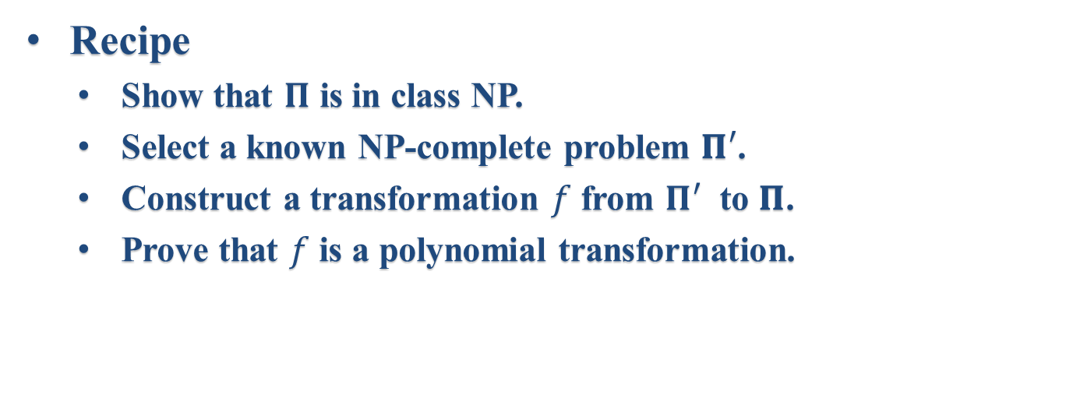
Steps of NP-Completeness Proof
Recipe
Show that 𝚷 is in class NP.
Select a known NP-complete problem 𝚷$′$.
Construct a transformation $f$ from ${\text{Π}}^{′}$ to 𝚷.
Prove that $f$ is a polynomial transformation.

Slide 3
Six Basic NP-Complete Problems
3-SATISFIABILITY (3SAT)
3-DIMENSIONAL MATCHING (3DM)
VERTEX COVER (VC)
CLIQUE
HAMILTONIAN CIRCUIT (HC)
PARTITION

Slide 4
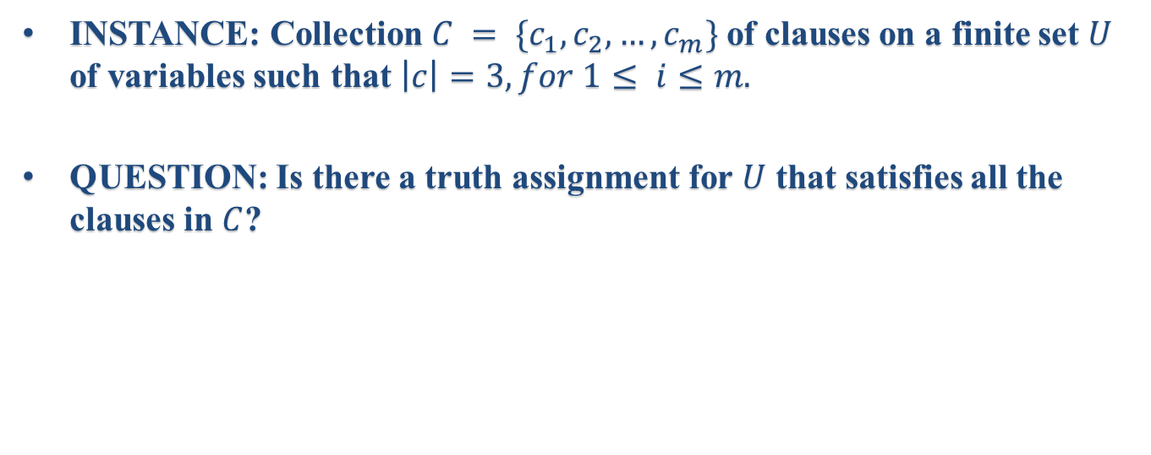
3-SATISFIABILITY (3SAT)
INSTANCE: Collection $C = \{c_{1}, c_{2}, …,c_{m}\}$of clauses on a finite set $U$ of variables such that $\left|c\right|=3, for 1≤ i≤m.$
QUESTION: Is there a truth assignment for $U$ that satisfies all the clauses in $C$?

Slide 5
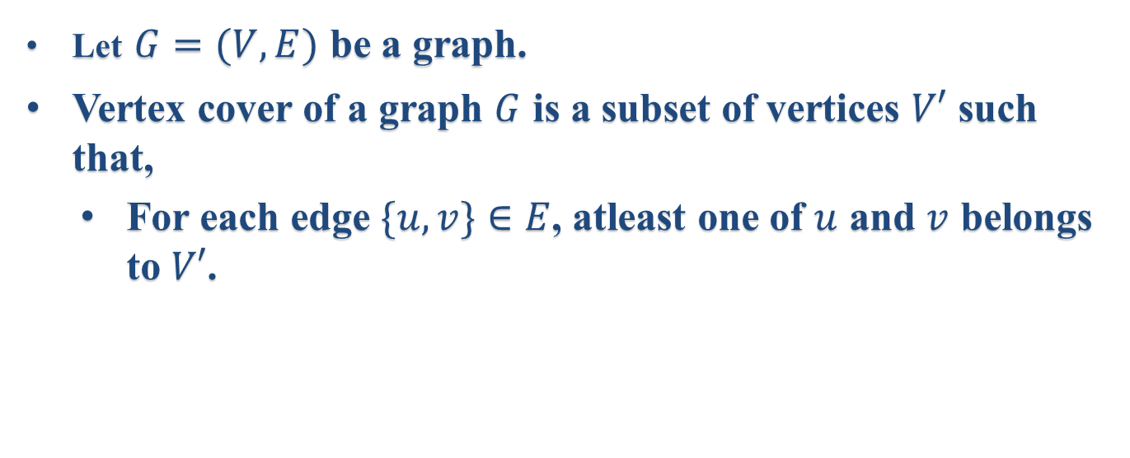
Vertex Cover
Let $G=(V,E)$ be a graph.
Vertex cover of a graph $G$ is a subset of vertices $V′$ such that,
For each edge $\{u,v\}∈E$, atleast one of $u$ and $v$ belongs to $V′$.

Slide 6
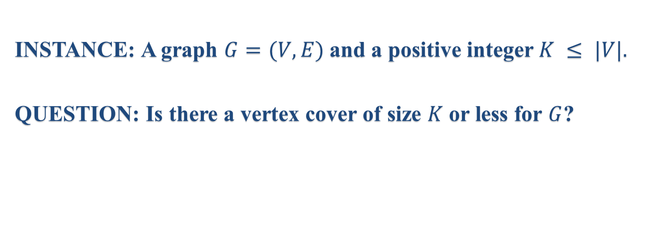
VERTEX COVER (VC) Problem
INSTANCE: A graph $G=(V,E)$and a positive integer $K ≤ |V|.$
QUESTION: Is there a vertex cover of size $K$ or less for $G$?

Slide 7
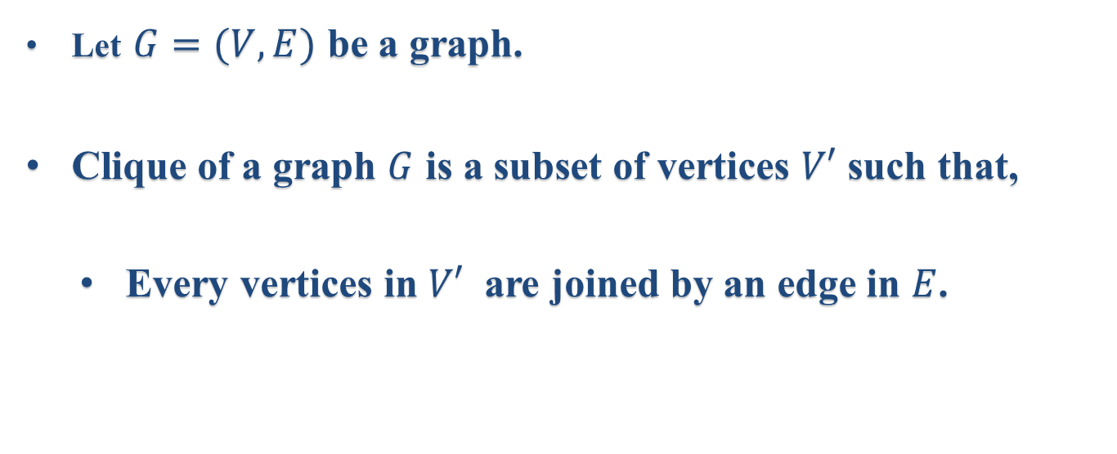
Clique
Let $G=(V,E)$ be a graph.
Clique of a graph $G$ is a subset of vertices $V′$ such that,
Every vertices in $V′$ are joined by an edge in $E$.

Slide 8
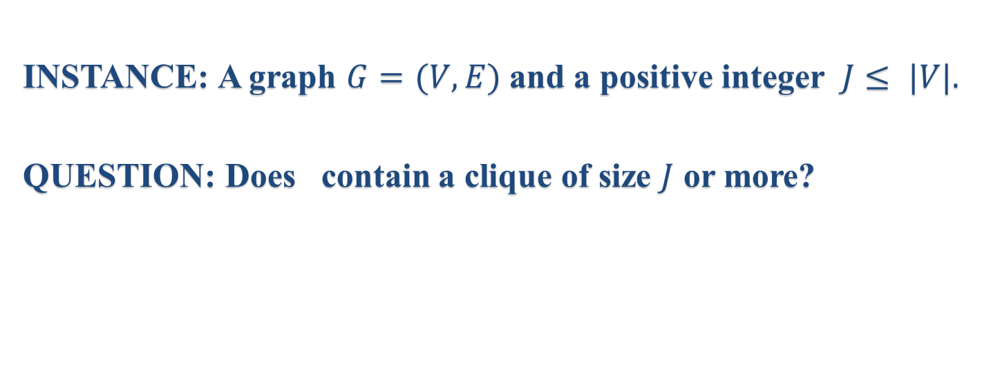
CLIQUE Problem
INSTANCE: A graph $G=(V,E)$and a positive integer $J≤ |V|.$
QUESTION: Does contain a clique of size $J$ or more?

Slide 9
Basics
Let $G = (V,E)$be a graph with vertex set $V$ and edge set $E$.
Simple Circuit in $G$.
It is a sequence $<v1,v2, . . . , vn>$of distinct vertices from $V$ such that
$\{ vi,v_{i+1}\} ∈ E$for $1≤i<k$and $\{ vk,v1\} ∈ E.$
A Hamiltonian circuit in $G.$
A simple circuit that includes all the vertices of $G.$

Slide 10
HAMILTONIAN CIRCUIT(HC) Problem
INSTANCE: A graph $G = (V,E).$
QUESTION: Does $G$ contain a Hamiltonian circuit?

Slide 11
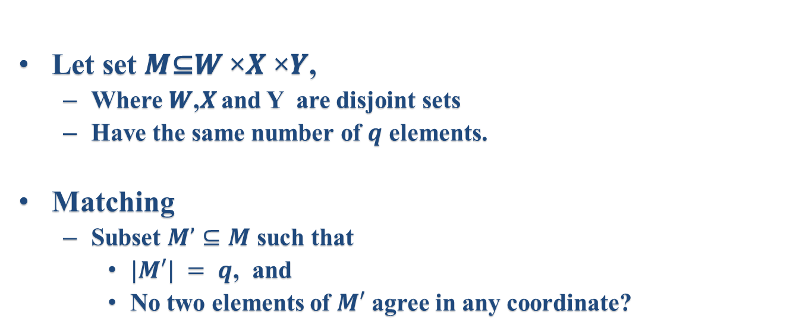
Matching
Let set 𝑴⊆𝑾 ×𝑿 ×𝒀,
Where 𝑾,𝑿 and Y are disjoint sets
Have the same number of $q$ elements.
Matching
Subset $M’⊆M$ such that
$|M′| = q$, and
No two elements of $M′$ agree in any coordinate?

Slide 12
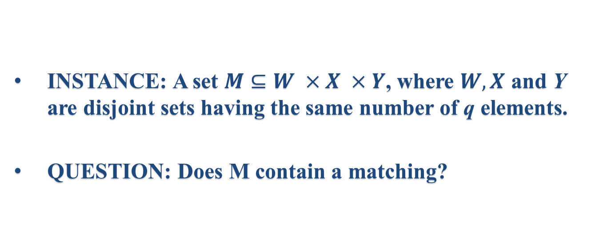
3-DIMENSIONAL MATCHING (3DM)
INSTANCE: A set $M⊆W ×X ×Y$, where $W,X$ and Y are disjoint sets having the same number of q elements.
QUESTION: Does M contain a matching?

Slide 13
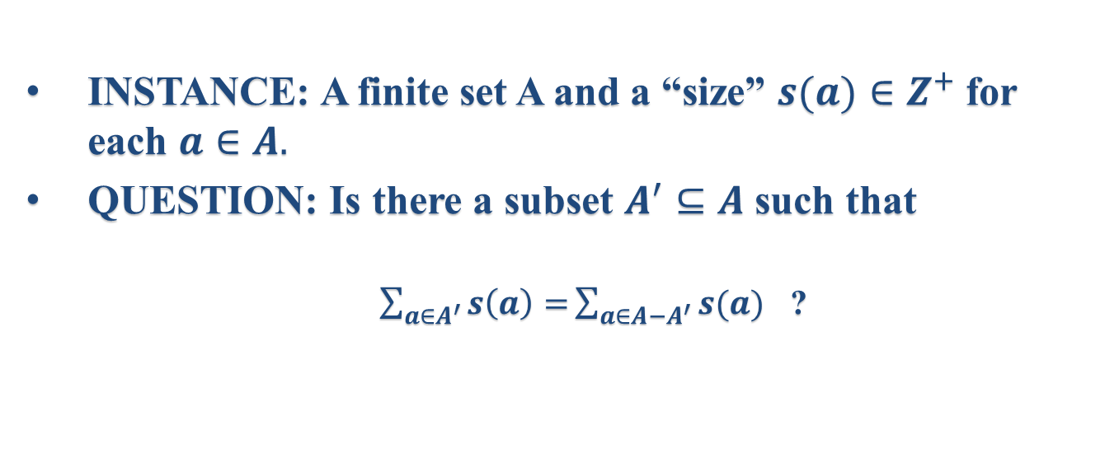
PARTITION
INSTANCE: A finite set A and a “size” $s(a)∈Z^{+}$ for each $a∈A.$
QUESTION: Is there a subset $A^{′}⊆A$ such that
$\sum_{a∈A^{′}}{s\left(a\right)=}\sum_{a∈A−A^{′}}{s(a)}$ ?

Slide 14
Why popular?
All appeared Karp’s original list of 21 NP-complete problems.

Slide 15
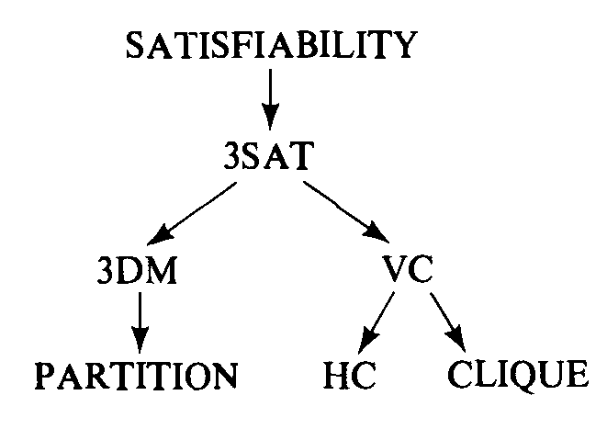
Michael Gary and David S Johnson’s Sequence

Slide 16
Reference

